Slide 1
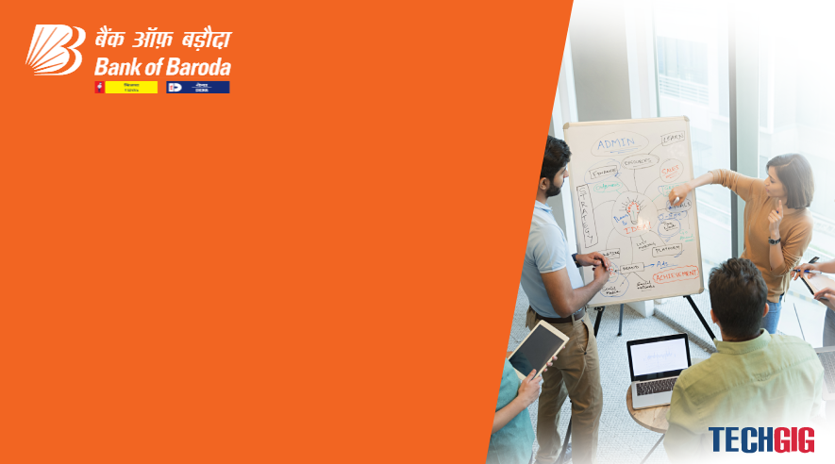

Bank of Baroda Hackathon - 2022
Technology Partner
Your Team Name : The A team
Your team bio : Just do it
Date : 20.09.2022

Slide 2
Problem Statement?
Why did you decide to solve this Problem statement? We have chosen this topic because it poses a certain challenge to us and help us test our skills in this domain. It enables us to project our view on how the future of visiting banks would be. Moreover, this has the potential to delve into the ever-evolving technological practices such as Web 3.0 and Metaverse.
This allows us to tackle the problems faced by common folks on their usual visits to bank as well as new customers who show interest to be a part of Bank of Baroda by projecting our unique perspective to better the experience whilst incorporating latest technologies.
The banking environment is usually anxious and overwhelming as they must handle more people than they can accommodate. The customers might need individual technical assistance but the current banking structure might not be able to provide it. Therefore, the avatar comes in handy to ease the burden on the employees and provide personalized assistance to the customers. This problem statement facilitates us to implement solutions to issues faced by everyone in the bank and we hope to provide a well-structured solution for an effective and efficient working of the bank.

Slide 3
User Segment & Pain Points
Which user /advertiser segment would be early adopter of your product & why?
The user base would be existing account holders of the Bank. This is because it is easier for these users to adopt the prototype and to compare the existing structure of banking with the proposed solution. They will be able to give us feedbacks and help us improve the avatar’s scalability.
PAIN POINTS
An account holder may not be familiar with the regional language
Opportunities to become financial advisors
Dispute processes not up to the speed
Inability to find documents quickly
The bottleneck of distributed paper processes

Slide 4
Pre-Requisite
What are the alternatives/competitive products for the problem you are solving?
The Net and Mobile banking
Google Translate
Virtual assistant for services like transactions and payments
Central bank digital currency (CBDC) that enables to open finance in a Web3.0 environment

Slide 5
Azure tools or resources
Azure tools or resources which are likely to be used by you for the prototype, if your idea gets selected The tools and resources likely to be used are: - Azure bot services - Azure form recognizer - Azure immersive reader - Speech to text - Speech translation - Spatial Anchors - Remote Rendering

Slide 6
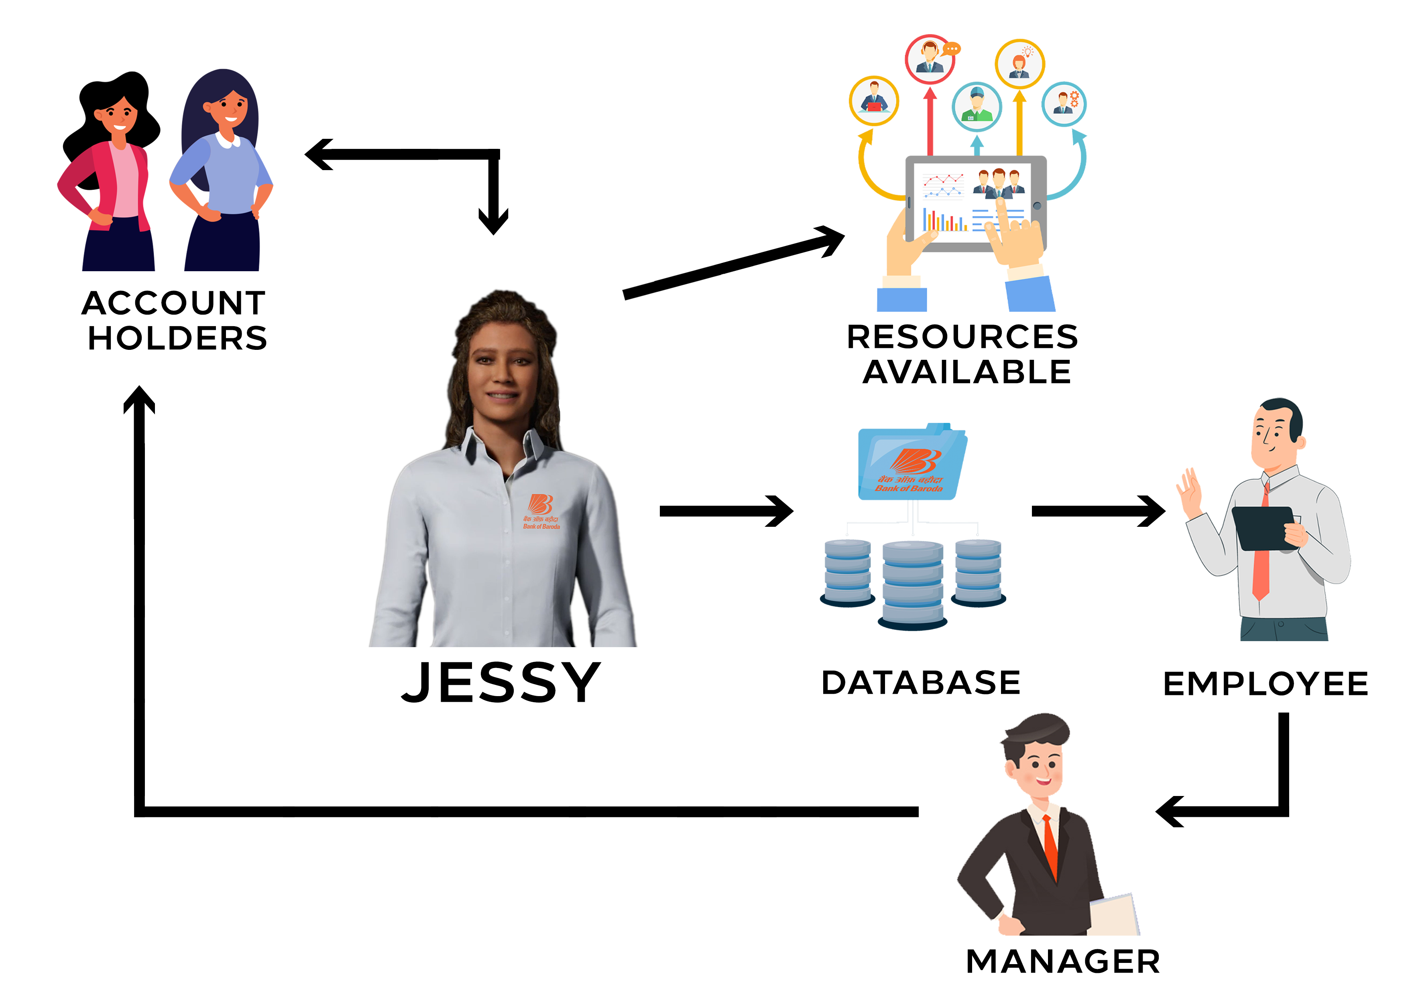
Any Supporting Functional Documents
Our proposed work flow of the solution and its architecture is as below:

Slide 7
Key Differentiators & Adoption Plan
How is your solution better than alternatives and how do you plan to build adoption?
Our solution is better than the alternatives because it proposes to solve more than one problem at a time. In our structure we have included the following aspects:
We have speech recognition technology by the use of conversational AI that helps us support multiple Indian languages.
The avatar created for this solution connects with the customers at a more personal level i.e., it is personalized for all the customers.As it is virtual it can help more than one person at a time.
The avatar helps us to replace all the paper work and also saves time of the customers.
It is a friendly avatar that also helps the new customers cope up with any social anxiety.

Slide 8
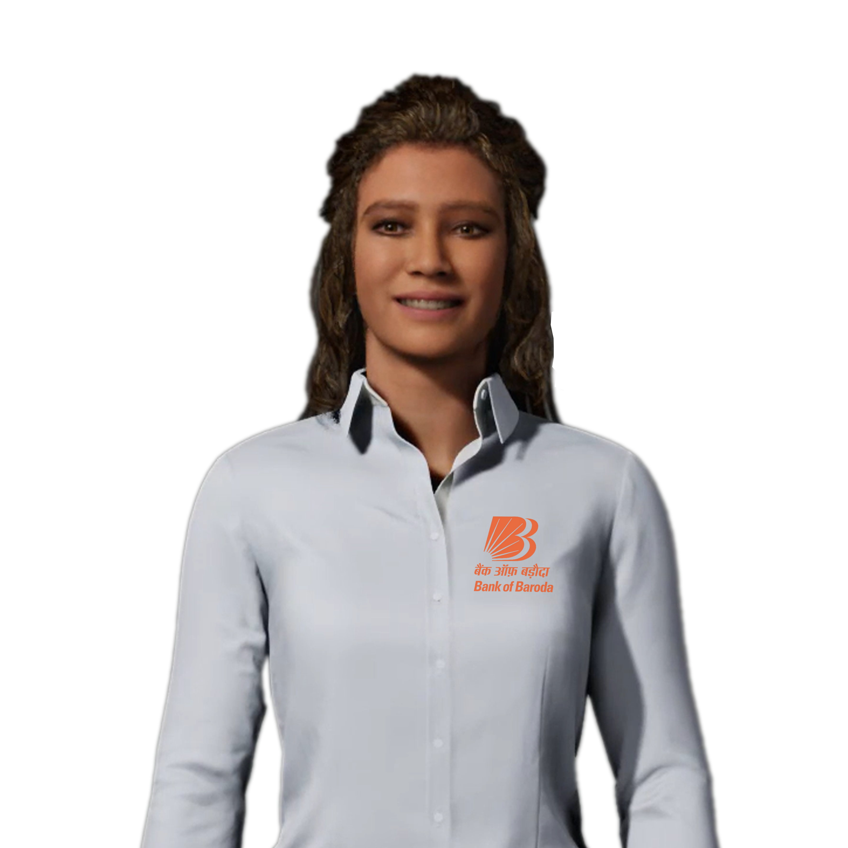
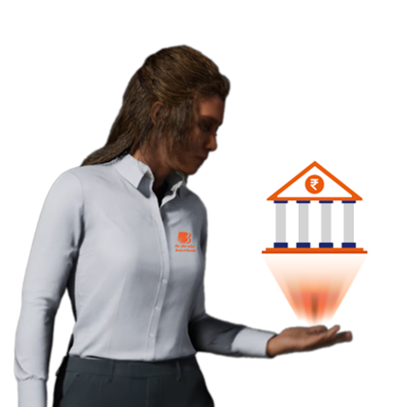
GitHub Repository Link & supporting diagrams, screenshots, if any
GitHub Repository Link: https://github.com/Priyanka-Masha/Bank-of-Baroda-Virtual-Avatar
Supporting Diagrams:

Slide 9
Thank You
Team member names:
Priyanka C
Noel Paatrick
Mohammed Irshad
Jaggajit Vasishta R

